Slide 1

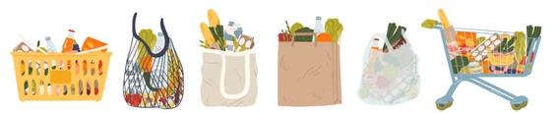
GROCERY STORE MANAGEMENT

Slide 2
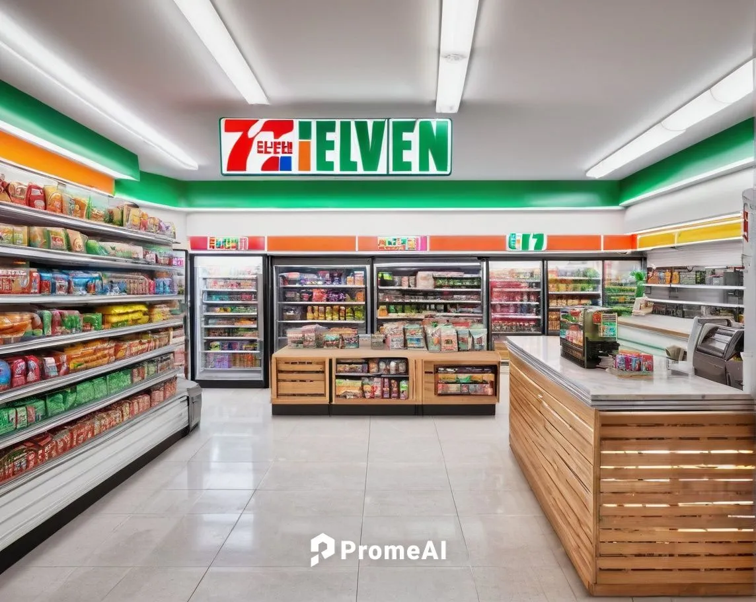
GROCERY
STORE MANAGEMENT

Slide 3

TEAM
MANEESH KUMAR SOMIREDDYPALLI
ADARSH GANTE
ROHIT DEBNATH

Slide 4
AGENDA
Introduction
Objectives of the Project
Problem statement
Tables
ER Diagram and schema explanation
SQL query results with screenshots
Insights
Recommendations
Summary

Slide 5


INTRODUCTION
Grocery Store Management System (GSM) is a database-driven application designed to
handle the daily operations of a grocery business.
It allows easy management of customers, suppliers, employees, products, categories, and
orders.
Using SQL as the backbone, the system ensures that all information is stored in a structured
and secure way.
GSM helps in tracking inventory levels, managing supplier details, and monitoring customer
purchases.
Store managers can quickly generate reports like sales history, most purchased products, and
supplier performance.
Overall, GSM improves business decision-making, customer satisfaction, and operational
efficiency.

Slide 6
OBJECTIVES
To design a centralized SQL database for storing and managing all grocery store information.
To simplify customer, supplier, employee, and product management.
To enable easy tracking of orders, sales, and transactions.
To provide accurate inventory management and avoid stock-out/overstock issues.
To improve data accuracy, reliability, and security compared to manual record-keeping.
To generate useful reports and insights for better business decision-making.
To save time, reduce manual errors, and ensure efficient store operations.

Slide 7
PROBLEM STATEMENT
Grocery stores generate large amounts of data every day from products, suppliers, customer purchases, and orders. However, without a structured system to organize and analyze this information, valuable insights often remain hidden. This leads to challenges in identifying best-selling products, tracking loyal customers, managing inventory efficiently, and understanding revenue trends.
The problem, therefore, is the lack of an integrated database and analytical framework that can transform raw transactional data into actionable business intelligence. Such a system should not only store and manage data effectively but also enable complex SQL-driven analysis—such as joins, aggregations, and filtering—to uncover patterns in sales, customer behavior, supplier performance, and profitability.

Slide 8
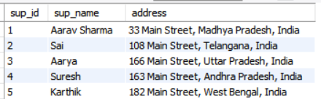
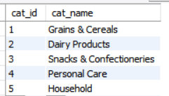
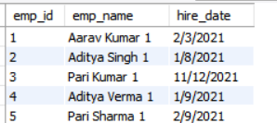
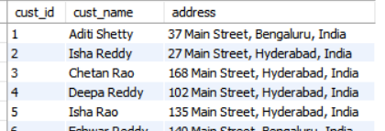
ABOUT TABLES
Category
Supplier
Employee
Customers

Slide 9
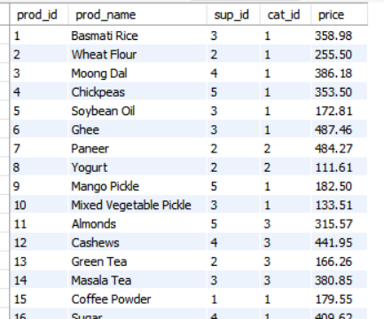
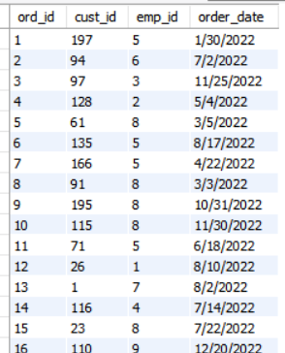
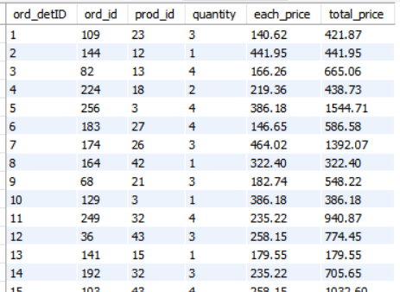
Products
Orders
Order_Details

Slide 10
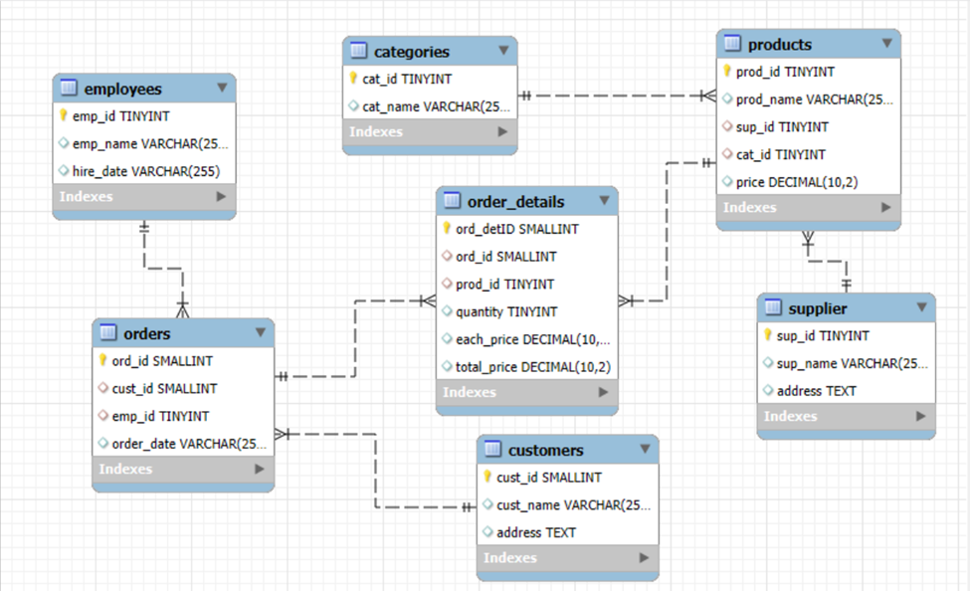
ER DIAGRAM

Slide 11
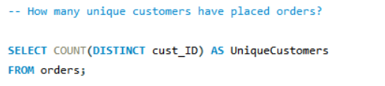
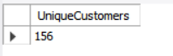

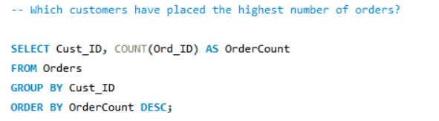
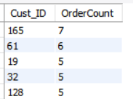
1. Customer Insights

Slide 12
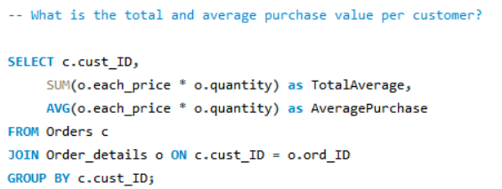
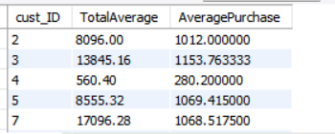
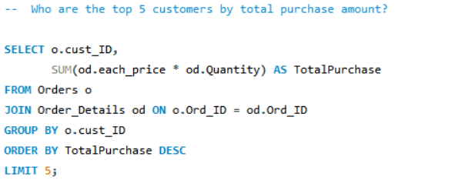
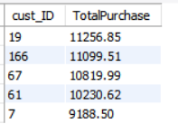

Slide 13
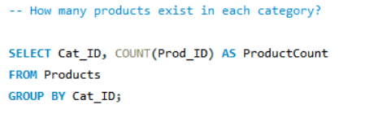
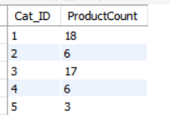
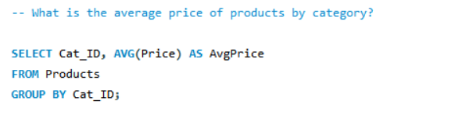
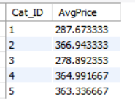
2.Product Peformance

Slide 14
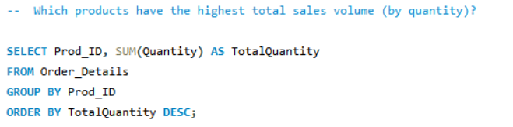
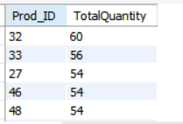
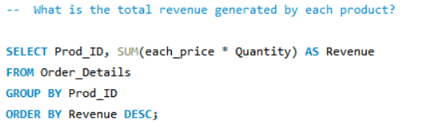
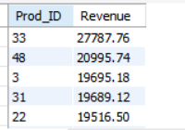

Slide 15
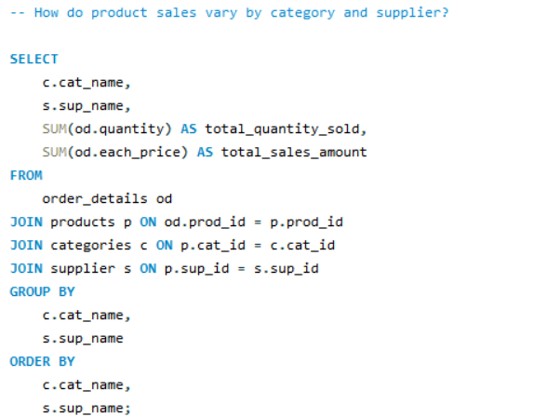
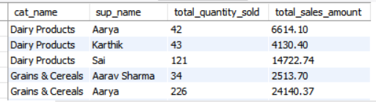

Slide 16
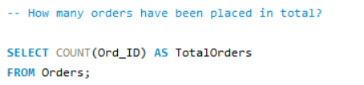
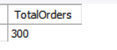
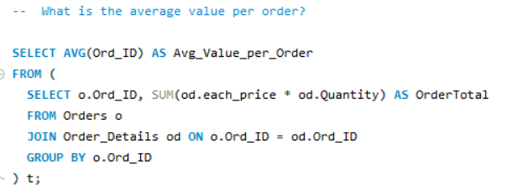
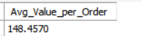
3. Sales and Order Trends

Slide 17
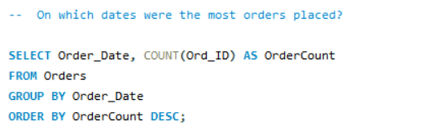
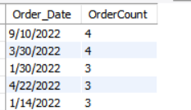
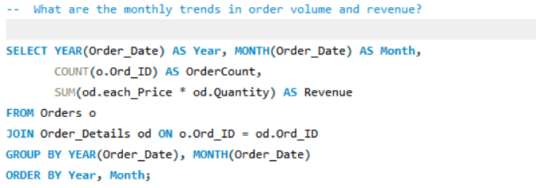
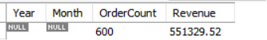

Slide 18
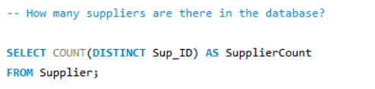
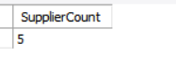
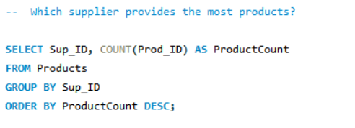
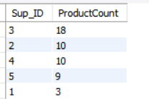
4️. Supplier Contribution

Slide 19
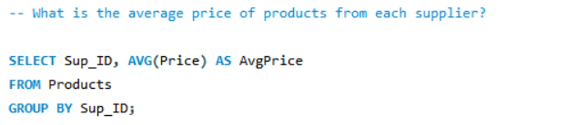
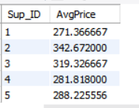
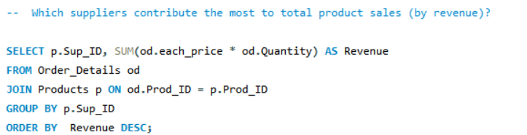
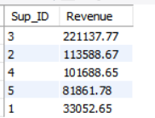

Slide 20
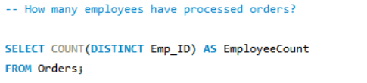
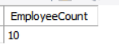
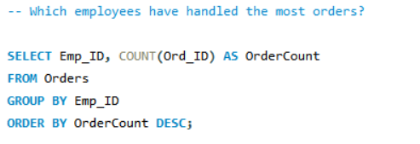
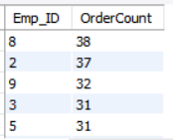
5. Employee Performance

Slide 21
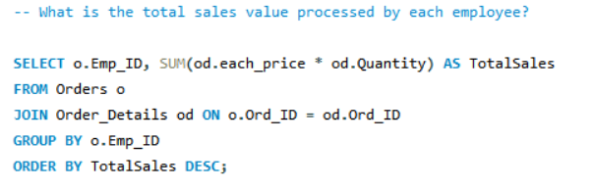
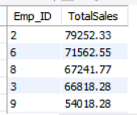



Slide 22


6️. Order Details Deep Dive

Slide 23





Slide 24
INSIGHTS
Customer Insights
Product Performance
Sales & Revenue Trends
Employee Performance
Suppliers Contribution
Order Details

Slide 25
RECOMMENDATION
Enhance Customer Loyalty:
Launch loyalty programs for top customers . Offer personalized discounts based on buying history.
Boost Product Sales:
Increase stock and promotion for best-selling items . Introduce bundle offers for slow-moving products.
Optimize Inventory:
Maintain safety stock for high-demand products . Reduce overstock of low-performing items.
Improve Supplier Relationships:
Prioritize reliable suppliers with consistent delivery . Negotiate better terms with high-performing suppliers.
Data-Driven Decision Making:
Continue using SQL reports for weekly/monthly insights . Integrate sales trends into marketing and stocking strategies.

Slide 26
SUMMARY
The Grocery Store Management System organizes and analyzes store data using SQL, enabling quick and accurate reporting.
It provides actionable insights to boost sales, manage inventory efficiently, and improve overall business decisions.

Slide 27


